Slide 1
FAULT DETECTION
Piero Baraldi,
Department of Energy, Politecnico di Milano

Slide 2
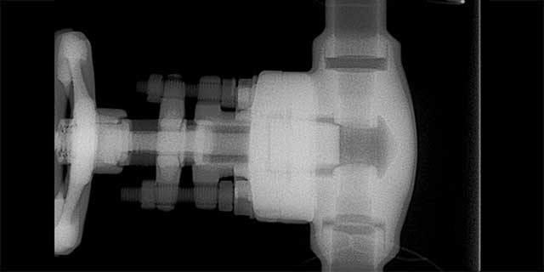

Context: Prognostics and Health Management
Equipment (System, Structure or Component)
Measured
signals
t
t
Detect
Diagnose
Predict
Anomalous
operation
Normal
operation
c₁
c₂
c₃
Remaining Useful Life
(RUL)
Malfunctioning type
(classes)
Notes:
The object of PHM is in general a system or a component or a structure. Basically we will consider something that can degrade [digreid], deteriorate [diterioreit] and have a failure. And we will consider some measured signals which are somehow related with the operation and the health state of our system/structure or component. What we want to do is, first of all, to detect (ditect) if our system is in a normal opeartion condition or if there is a problem, anomalous/abnormal operatation. Inthis latter case we want to be able to diagnose the type of fault which has caused the anomaly. Finally we would also like to know the remaiing useful llife of our component that is the amount of time the equipment will continue to perform its function.

Slide 3
In This Lecture: Fault Detection
Equipment (System, Structure or Component)
Measured
signals
t
t
Detect
Diagnose
Predict
Anomalous
operation
Normal
operation
c₁
c₂
c₃
Remaining Useful Life
(RUL)
Malfunctioning type
(classes)
Notes:
The object of PHM is in general a system or a component or a structure. Basically we will consider something that can degrade [digreid], deteriorate [diterioreit] and have a failure. And we will consider some measured signals which are somehow related with the operation and the health state of our system/structure or component. What we want to do is, first of all, to detect (ditect) if our system is in a normal opeartion condition or if there is a problem, anomalous/abnormal operatation. Inthis latter case we want to be able to diagnose the type of fault which has caused the anomaly. Finally we would also like to know the remaiing useful llife of our component that is the amount of time the equipment will continue to perform its function.

Slide 4
Fault Detection: What is?
Automatic algorithm
Normal condition
EQUIPMENT
Measured
signals
Notes:
Typically our equipment is in steady state, the signal that we monitor are …

Slide 5
Fault Detection: What is?
Automatic algorithm
Normal condition
EQUIPMENT
Measured
signals

Slide 6

Fault Detection: What is not?
Automatic algorithm
Normal condition
EQUIPMENT
f₁
Measured
signals
f₂

Slide 7
Fault Detection: Approaches
Limit-based
Model-based
Data-driven

Slide 8
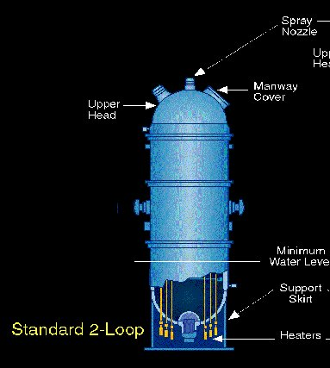
Limit-based fault detection: data & information
Normal operation ranges of key signals
Example:
Pressurizer of a nuclear reactor
Water level
Abnormal condition
10.2 m
Normal operation
range
3.8 m
Abnormal condition
time

Slide 9

Limit-based fault detection: the method
Normal operation ranges of key signals
Limit Value-Based Fault Detection
Example:
Pressurizer of a nuclear reactor
Water level
Abnormal condition
10.2 m
Normal operation
range
3.8 m
Abnormal condition
time

Slide 10
Limit-based fault detection: Limitations
Normal operation ranges of key signals
Limit Value-Based Fault Detection
Limitations:
No early detection
Not applicable to fault detection during operational transients
Control systems operations may hide small anomalies (the signal remains in the normal range although there is a process anomaly)
Considering signal individually can delay detection
Example:
Pressurizer of a PWR nuclear reactor
Water level
Abnormal condition
10.2 m
Normal operation
range
3.8 m
Abnormal condition
time

Slide 12
Fault Detection: Approaches
Limit-based
Model-based
Data-driven

Slide 13
Model-based & Data-driven fault detection: basic idea
Signal
reconstructions
Real
measurements
MODEL OF THE
EQUIPMENT BEHAVIOR
IN NORMAL CONDITION
= ?
Statistical Test
Equipment
Normal
Condition
Abnormal
Condition

Slide 14
Fault Detection: Approaches
Limit-based
Model-based
Data-driven

Slide 15
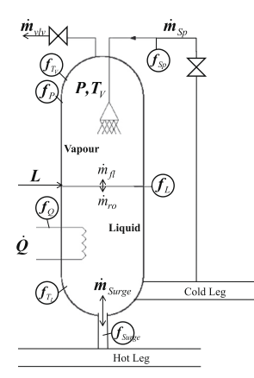
Model-based fault detection: data & information
Physics-based model of the process (used to reproduce the expected behavior of the signals in normal condition)
Example:
Signal
reconstructions
Pressurizer model

Slide 16
Model-based fault detection: limitations
Physics-based model of the process (used to reproduce the expected behavior of the signals in normal condition)
Example:
Signal
reconstructions
Real
measurements
Pressurizer model
≠
Typically not available for complex systems
Long computational time
Abnormal Condition

Slide 17
Fault Detection: Approaches
Limit-Based
Model Based
Data-driven

Slide 18
Data-driven fault detection: data & information
Historical signal measurements in normal operation
Example:
Pressure | Liquid temperature | Steam temperature | Spray flow | Surge line flow | Heaters power | Level
150.2 | 321 | 362 | 539 | 244 | 0 | 7.2
150.4 | 322 | 363 | 681 | 304 | 0 | 7.5
150.3 | 323 | 364 | 690 | 335 | 1244 | 7.7
… | … | … | … | … | … | …
Pressure
Water level

Slide 19
Example of Application 1*
19
COMPONENT TO Reactor Coolant Pump of PWR
BE MONITORED Nuclear Power Plant
x4
__________________________________________________
: 4
Measured signals | 48 (Temperatures, pressures, flows,…)
Available data | Historical signal measurements in normal plant condition [1 year, frequency=1/30 Hz]
* Work developed with EDF-R&D

Slide 20

Example of Application 2
Measured signals | 6 vibration signals measured by accelerometers
Available data | Historical signal measurements in normal plant condition [3 years, frequency=5 kHz]
Notes:
Generator, gearbox [giirbox], bearing

Slide 21
Data-driven fault detection: possible methods
Statistical Approaches:
AutoAssociative Kernel Regression (AAKR)
Principal Component Analysis (PCA)-based
…
Artificial Intelligence (AI)-based
Feedforward Neural Networks (FNNs)
AutoAssociative Neural Networks (AANNs)
AutoEncoders (AEs)
Self Organizing Maps
…

Slide 22
In This Lecture
Signal
reconstructions
Real
measurements
Part 1
Part 2
MODEL OF THE
EQUIPMENT BEHAVIOR
IN NORMAL CONDITION
= ?
Statistical Test
Equipment
Normal
Condition
Abnormal
Condition

Slide 23
PART 1: Model of the Equipment Behaviour in Normal Condition
Auto Associative Kernel Regression (AAKR)
Principal Component Analysis (PCA)

Slide 24
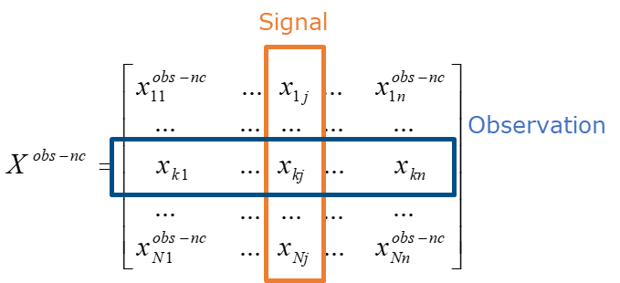
What do we need?
Data in normal conditions
obs-nc = observation in normal condition
Notes:
Independently form the specific method…

Slide 25
Training set, input and output
Training patterns: Historical signal measurements in normal condition
Test input: Signals measured at current time
Test Output: Signal reconstructions (expected values of the signals in normal condition)
Signal
Observation
Model of the equipment behaviour in normal conditions

Slide 26

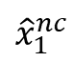
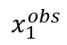
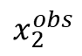
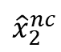
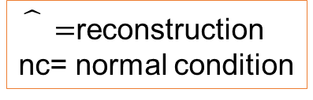
Requirement I
Equipment is in normal condition
Signal
Reconstructions
Real
Measurements
MODEL OF THE
EQUIPMENT BEHAVIOR
IN NORMAL CONDITION
$${\hat{x}}_{1}^{nc}$$
$$x_{1}^{obs}$$
t
t
$${\hat{x}}_{2}^{nc}$$
$$x_{2}^{obs}$$
t
t
…
…
$${\vec{\hat{x}}}^{nc} ≅{ \vec{x}}^{obs}$$
$\hat{}=$reconstruction
nc= normal condition

Slide 27

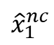
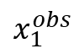
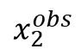

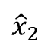
Requirement II
Equipment is in abnormal condition
Signal
Reconstructions
Real
Measurements
MODEL OF THE
EQUIPMENT BEHAVIOR
IN NORMAL CONDITION
$${\hat{x}}_{1}^{nc}$$
$$x_{1}^{obs}$$
t
t
$${\hat{x}}_{2}$$
$$x_{2}^{obs}$$
t
t
…
…
$${\vec{\hat{x}}}^{nc} ≠{ \vec{x}}^{obs}$$

Slide 28
PART 1: Model of the Equipment Behaviour in Normal Condition
1A) Auto Associative Kernel Regression (AAKR)
1B) Principal Component Analysis (PCA)

Slide 29
AAKR: Training set, input and output = Slide 21
Training patterns: Historical signal measurements in normal condition
Test input: Signals measured at current time
Test Output: Signal reconstructions (expected values of the signals in normal condition)
Signal
Observation
AAKR

Slide 30
AAKR: the algorithm (1)
Training patterns:
Test input : measured signals at current time
Test output : weighted sum of the training patterns
x₂
On all the
training pattern
x₁
Notes:
A weighted average of all observed j-th signal

Slide 31
AAKR: the algorithm (2)
Output = weighted sum of the training patterns:
Notes:
You associate a weight to each one of the training pattern.

Slide 33
AAKR: the algorithm (2)
Output = weighted sum of the training patterns:
weights w(k) = similarity measures between and (the test and the k-th training pattern):
low weight
high weight
h = bandwidth parameter (it controls the decay speed)
Notes:
You associate a weight to each one of the training pattern.

Slide 34
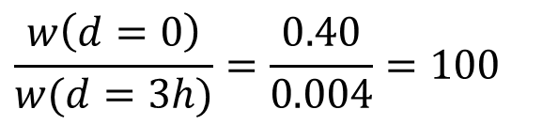
AAKR: parameter h setting
d=0 → w=0.40/h
d=h → w=0.24/h
d=2h → w=0.05/h
d=3h → w=0.004/h
$$\frac{w\left(d=0\right)}{w(d=3h)}=\frac{0.40}{0.004}=100$$
w
d

Slide 35
AAKR: the algorithm (2)
Output = weighted sum of the training patterns:
weights w(k) = similarity measures between and (the test and the k-th training pattern):
with Euclidean distance between and
low weight
high weight
Notes:
You associate a weight to each one of the training pattern.

Slide 36
AAKR: Exercise 1
Signal values at current time:
Historical signal measurements in normal plant condition:
x₂
Question 1) Where do you expect to be the
Signal reconstruction ?
Question 2) Is the plant in normal or abnormal conditions?
x₁

Slide 37
Exercise 1: Solution
Signal values at current time:
Signal reconstructions: based on the available historical signal measurements in normal plant condition
x₂
normal condition
x₁

Slide 38
AAKR: Exercise 2
Signal values at current time:
Historical signal measurements in normal plant condition:
x₂
Question 1) Where do you expect to be the
signal reconstruction ?
Question 2) Is the plant in normal or abnormal conditions?
x₁

Slide 39
Exercise 2: Solution
Signal values at current time:
Signal reconstructions: based on the available historical signal measurements in normal plant condition
x₂
abnormal condition
x₁
available historical signal measurements in normal plant condition
Notes:
The method is able to understand that in this case, of abnormal conditionm the relationship between x1 and x2 is different from the relationship between x1 and x2 in the training pattern, in the normal condition pattern.

Slide 40
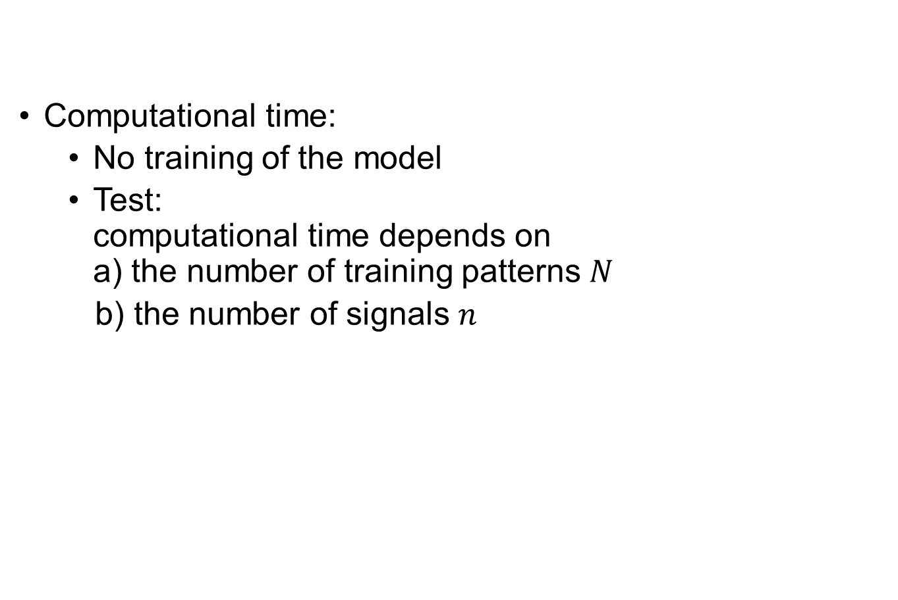
AAKR remarks: Computational Time
Computational time:
No training of the model
Test: computational time depends on a) the number of training patterns $N$
b) the number of signals $n$
Notes:
condition monitoring → on-line application. We want to know now if the plant is in a normal or abnormal condition. So, for example, if we have to wait 10 minutes for the computation of the output, the method would be not feaseable. In case of large

Slide 41
AAKR remarks: Accuracy
Accuracy:
depends on the training set:
↑N → ↑ Accuracy
x₂
Few patterns and not well
distributed in the training space
Inaccurate reconstruction
x₁
Notes:
condition monitoring → on-line application. We want to know now if the plant is in a normal or abnormal condition. So, for example, if we have to wait 10 minutes for the computation of the output, the method would be not feaseable. In case of large

Slide 42
AAKR remarks
Pros:
No need of hypothesis on data distribution (e.g. linearity)
Cons
Performance related to number of training observations

Slide 43
PART 1: Model of the Equipment Behaviour in Normal Condition
1A) Auto Associative Kernel Regression (AAKR)
1B) Principal Component Analysis (PCA)

Slide 44

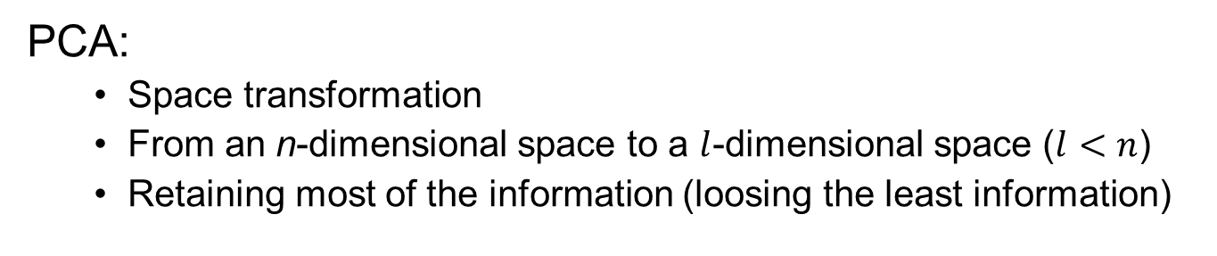
PCA: What is it?
PCA:
Space transformation
From an n-dimensional space to a $l$-dimensional space ($l<n$)
Retaining most of the information (loosing the least information)
x₃
x₁
x₂
Notes:
PCA is very famous and used techniques in many fields… Let us introduce it from a mathametical point of view. We have these points in a 3-dimensional space defined by x1,x2,x3 ….3 signals. A point can be described by giving its coordinate with respect to x1, x2 and x3 or by considering other 3 axes (changing reference system). PCA is first of all changing the reference system: it goes from x1,x2, xe to the one defined by PC1, PC2, and PC3…
In many applications we are interested to describe the information using less dimensions. In this case, for example, instead of using a reference system defined by n=3 axes, we want to use l=2 dimensions.
Now the questions is how to find the 2 dimensions with retaiing most of the information. We want to catch the intrinsic nature of the data by using only 2 dimensions. In this case for example the data form 3 clusters represented by … If we want to maintaining the clusters in 2 dimensions, a good representation is to consider the plane defined by PC1 and PC2 (reference system).

Slide 45
IDEA OF PCA
Two signals are highly correlated or dependent ➔One is enough!
Key underlying phenomena ➔ Areas of variance in data ➔ Focus on directions along which the observations have largest variance
Notes:
Now, we have the problem of deciding which is the best reference system, the one that allows to loose the least information. Let us consider this trivial example … it is really needed to consider 2 dimensions to describe them? No this direction u is enough.
Now let us consider these other points that describe a physical phenomenon. What is meaningful from a physical point of view in these data? Probably, what is happening in the direction In red… What is the characteristic of this direction? It is the direction of maximum variability of the data. So, we can think that there is a process that is moving the data along the u direction, what is happening in the other directions can be thought as noise

Slide 46
PCA: Training set, input and output = Slide 21 and Slide 25
Training patterns: Historical signal measurements in normal condition
Test input: Signals measured at current time
Test Output: Signal reconstructions (expected values of the signals in normal condition)
Signal
Observation
PCA
Notes:
Now we go back to our problem of fault detection. We want to perform signal reconstructions. This is exactly the same problem setting that we have tackled with the AAKR

Slide 47
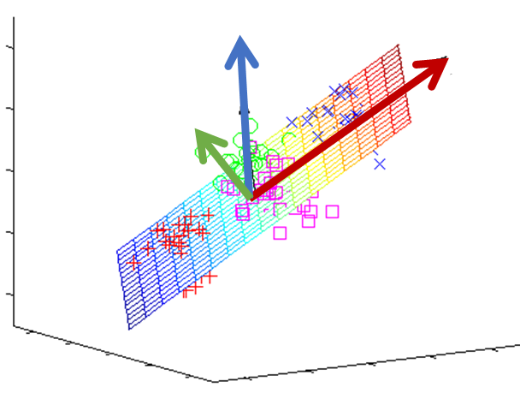
PCA for fault detection: operational steps (1)
Step 1: find Principal Components (PCs) in the training set :
PC1 is the direction of maximum variance
PC2 is orthogonal to PC1 and describes the maximum residual variance
PC3 is orthogonal to PC1 and PC2 and describes the maximum residual variance

Slide 48
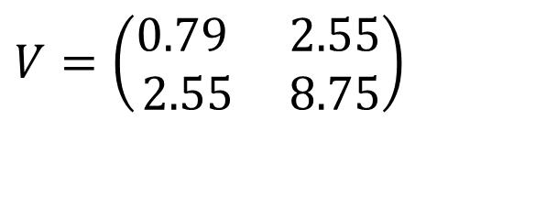

Step 1: Mathematical details (1A)
Objective: find principal components
Procedure:
Compute $V$= covariance matrix of $X^{obs−nc}$
Empirical
mean
matrix
$$V=\left(\begin{matrix}\text{0.79} & \text{2.55} \\ \text{2.55} & \text{8.75}\end{matrix}\right)$$

Slide 49
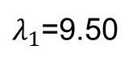
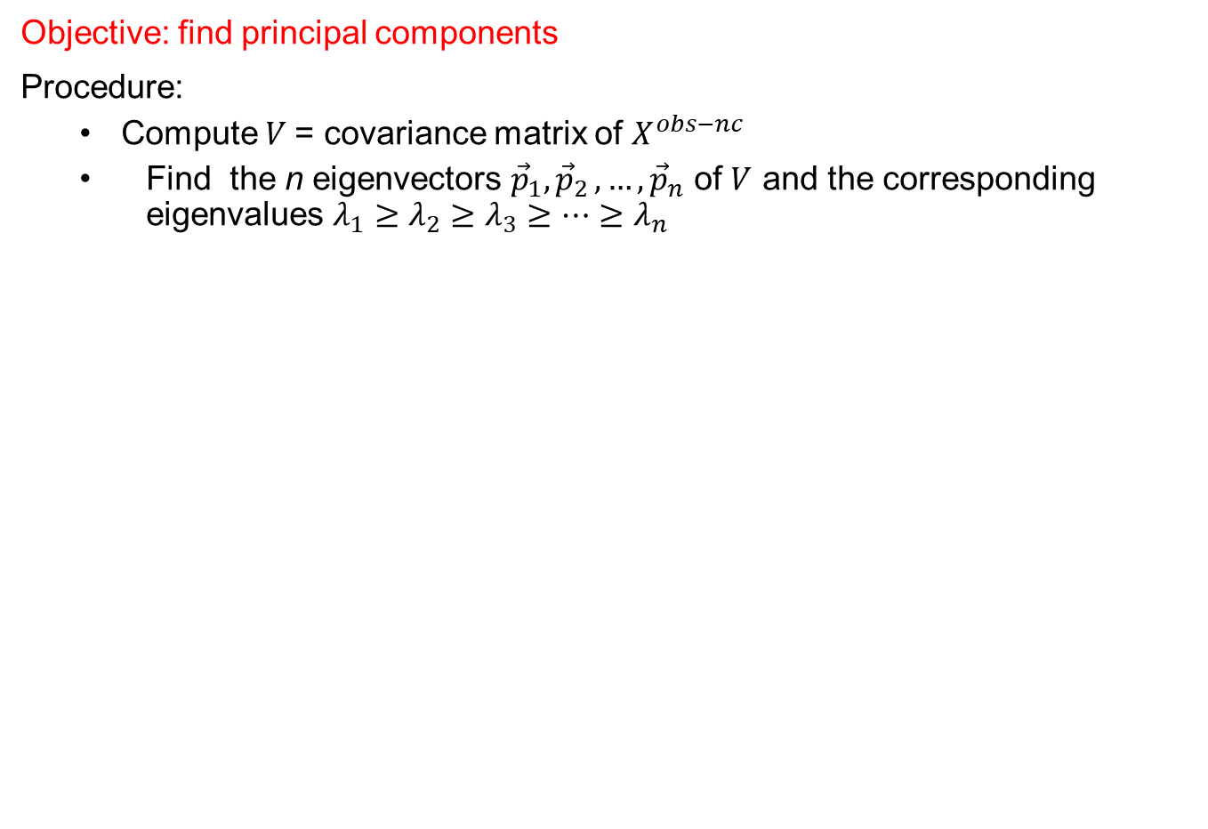
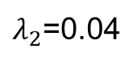
Step 1: Mathematical Details (1B)
Objective: find principal components
Procedure:
Compute $V$= covariance matrix of $X^{obs−nc}$
Find the n eigenvectors ${\vec{p}}_{1}{,\vec{p}}_{2},…,{\vec{p}}_{n}$ of $V$ and the corresponding eigenvalues $λ_{1}≥λ_{2}≥λ_{3}≥…≥λ_{n}$
$λ_{1}$=9.50
largest
$λ_{2}$=0.04
smallest

Slide 51
Step 1: Properties of the PCs (I)
P is an orthonormal basis:

Slide 52
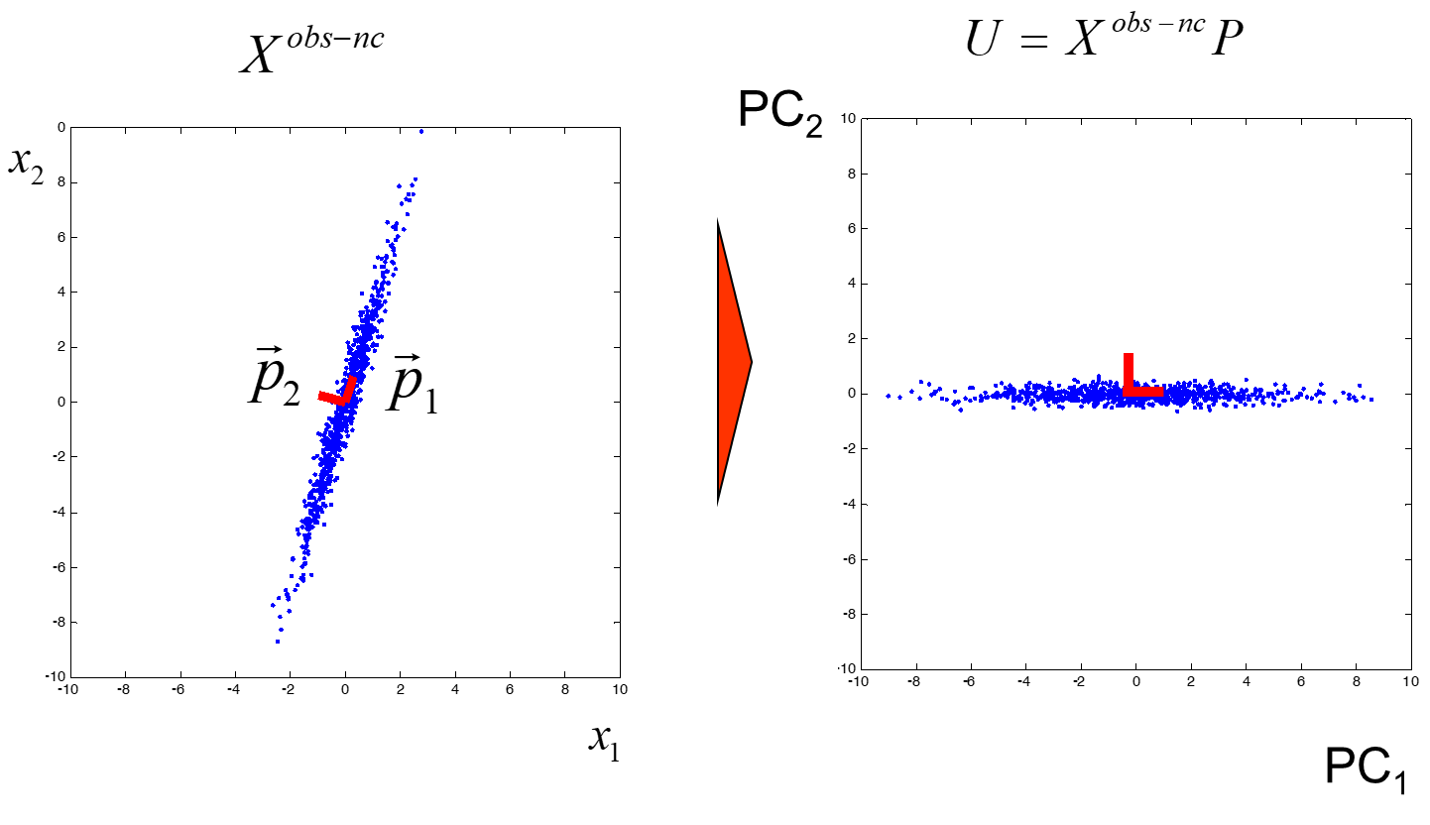
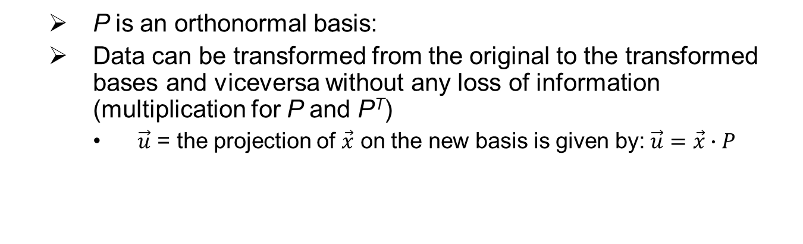
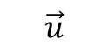
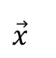
Step 1: Properties of the PCs (II)
P is an orthonormal basis:
Data can be transformed from the original to the transformed bases and viceversa without any loss of information (multiplication for P and P^{T})
$\vec{u}$ = the projection of $\vec{x}$ on the new basis is given by:$\vec{u}=\vec{x}∙P$
$\vec{x}$
$$\vec{u}$$

Slide 53
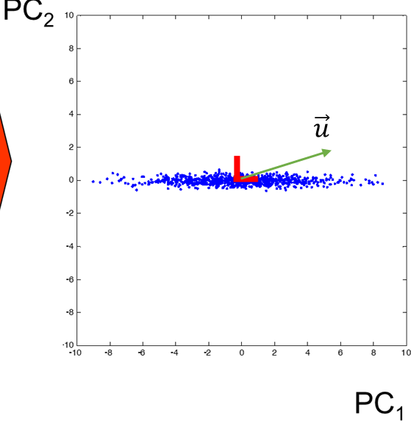
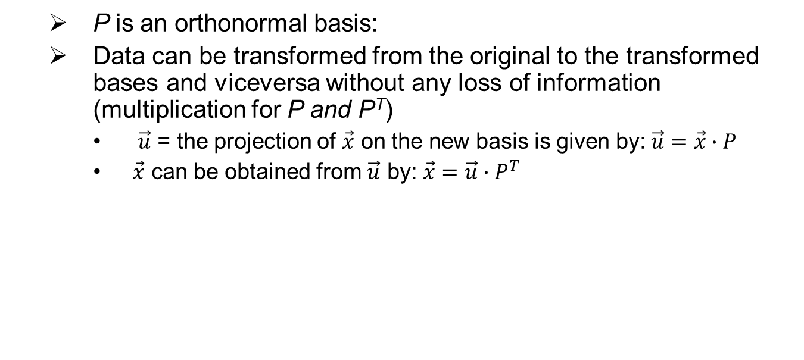
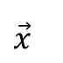
Step 1: Properties of the PCs (III)
P is an orthonormal basis:
Data can be transformed from the original to the transformed bases and viceversa without any loss of information (multiplication for P and P^{T})
$\vec{u}$ = the projection of $\vec{x}$ on the new basis is given by:$\vec{u}=\vec{x}∙P$
$\vec{x}$ can be obtained from $\vec{u}$ by: $\vec{x}=\vec{u}∙P^{T}$
$\vec{x}$

Slide 54
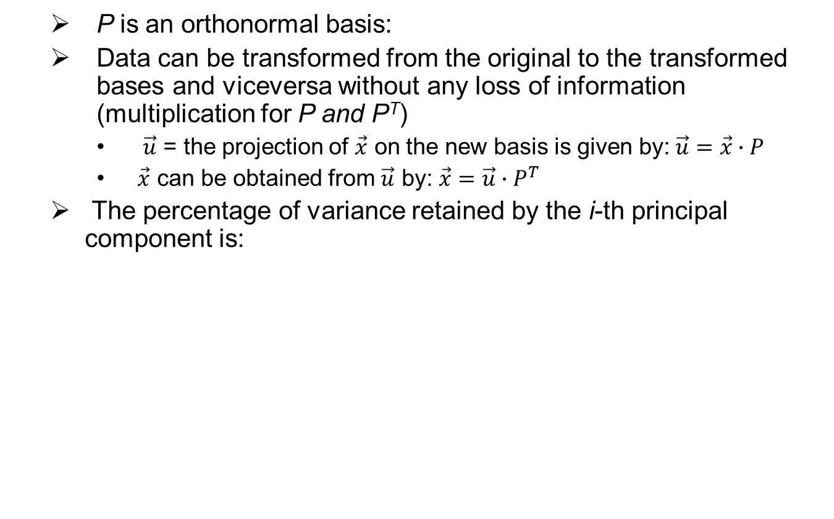
Step 1: Properties of the PCs (III)
P is an orthonormal basis:
Data can be transformed from the original to the transformed bases and viceversa without any loss of information (multiplication for P and P^{T})
$\vec{u}$ = the projection of $\vec{x}$ on the new basis is given by:$\vec{u}=\vec{x}∙P$
$\vec{x}$ can be obtained from $\vec{u}$ by: $\vec{x}=\vec{u}∙P^{T}$
The percentage of variance retained by the i-th principal component is:

Slide 55
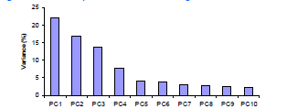
PCA for fault detection: operational steps (2)
Step 2 [PCA approximation]: ignore the PCs of lower significance.
Lost small information
Reduce the number of dimensions from n=10 to = 4

Slide 56
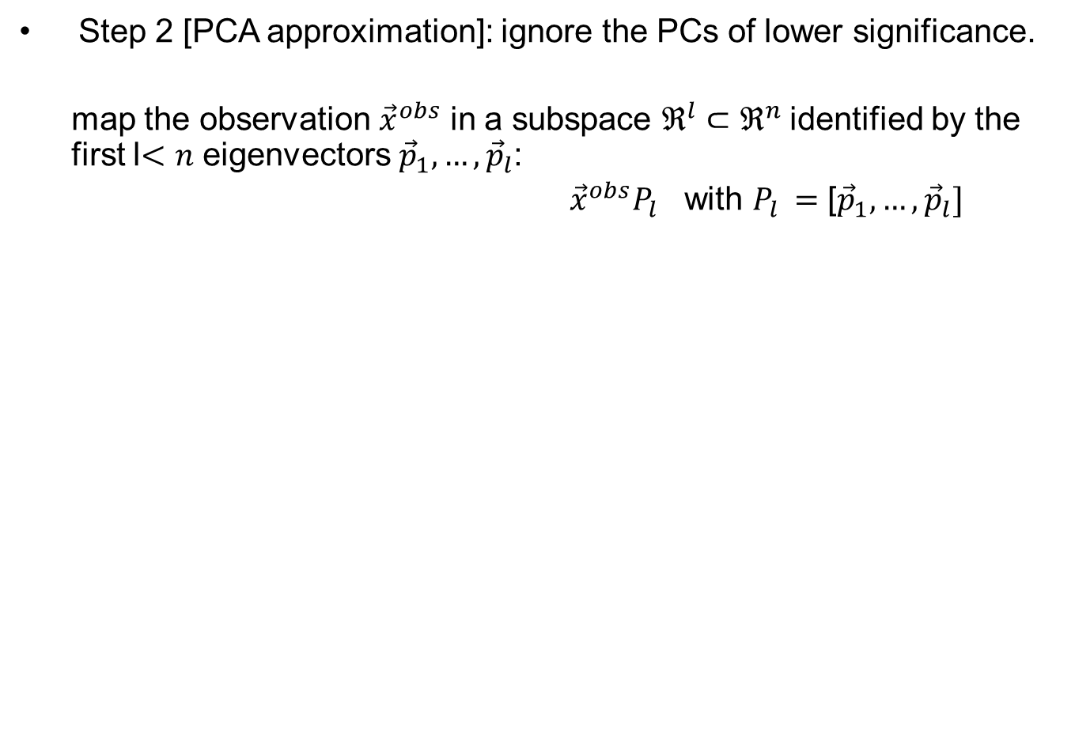
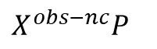
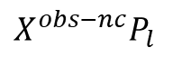
PCA for fault detection: operational steps (2)
Step 2 [PCA approximation]: ignore the PCs of lower significance.
map the observation ${\vec{x}}^{obs}$ in a subspace $ℜ^{l}⊂ℜ^{n}$identified by the first l$<n$ eigenvectors ${\vec{p}}_{1}, …,{\vec{p}}_{l}$:
${\vec{x}}^{obs}P_{l}$ with $P_{l }=$ [${\vec{p}}_{1}, …,{\vec{p}}_{l}]$
Example of application to the normal condition data: $X^{obs−nc}$
$$X^{obs−nc}P$$
PC2
$$X^{obs−nc}P_{l }$$
PC1
PC1
We consider only the directions that are most meaningful in normal condition (directions of maximum variance)

Slide 57
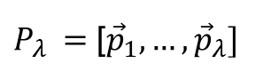
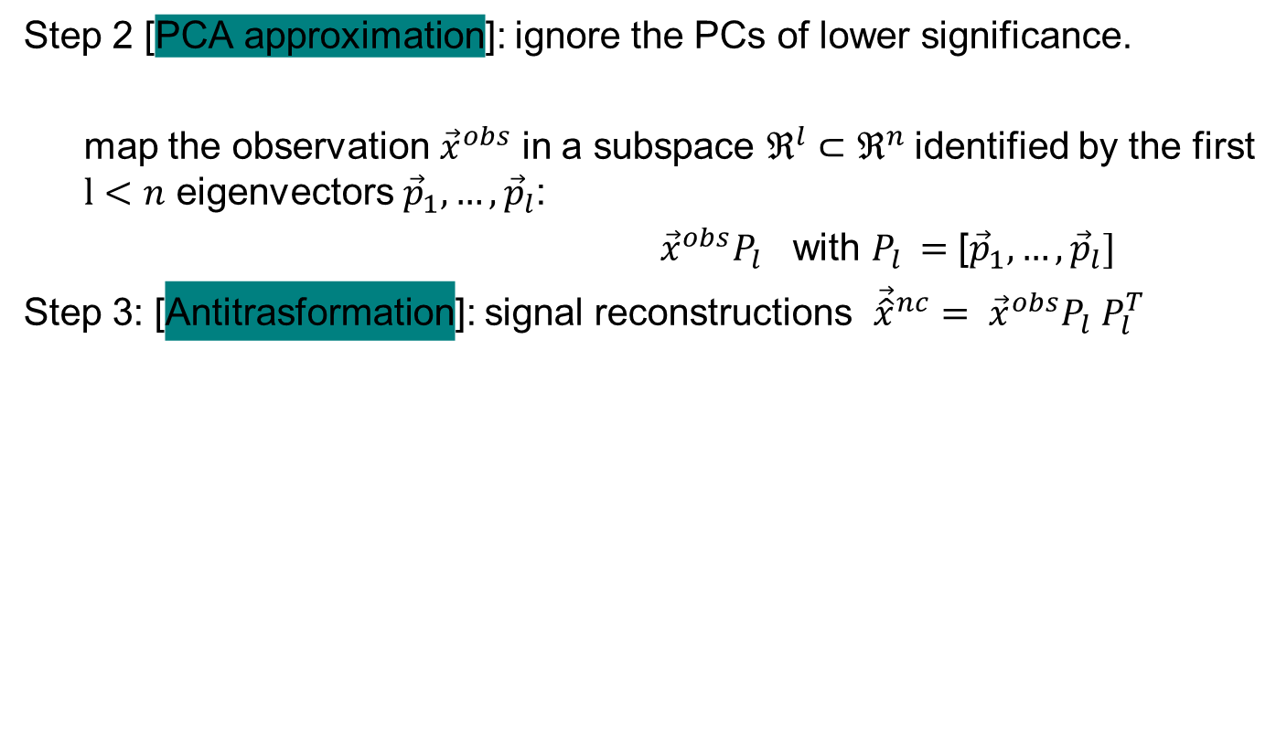
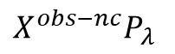
PCA for fault detection: operational steps (3)
Step 2 [PCA approximation]: ignore the PCs of lower significance.
map the observation ${\vec{x}}^{obs}$ in a subspace $ℜ^{l}⊂ℜ^{n}$identified by the first $l<n$ eigenvectors ${\vec{p}}_{1}, …,{\vec{p}}_{l}$:
${\vec{x}}^{obs}P_{l}$ with $P_{l }=$ [${\vec{p}}_{1}, …,{\vec{p}}_{l}]$
Step 3: [Antitrasformation]: signal reconstructions ${{\vec{\hat{x}}}^{nc}= \vec{x}}^{obs}P_{l} {P_{l}^{T}}_{ }$
Example of application to the normal condition data: $X^{obs−nc}$
$P_{λ }=$ [${\vec{p}}_{1}, …,{\vec{p}}_{λ}]$
We loose the noise in the space of the measured signals
$$X^{obs−nc}P_{λ }$$
PC1

Slide 58
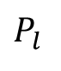
PCA for fault detection: Summary
Historical data
$$P_{l}$$
Find from

Slide 59
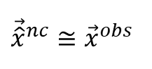
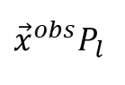
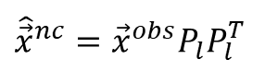
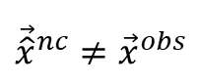
PCA for fault detection: Summary
Historical data
Measured signals at present time:
Trasform and project
Antitrasform
$$P_{l}$$
Find from
I’m looking at the measurements
considering only the directions that
are most meaningful in normal
condition (directions of maximum variance)
$${\vec{x}}^{obs}P_{l}$$
$${\hat{\vec{x}}}^{nc}={\vec{x}}^{obs}P_{l}P_{l}^{T}$$
Signal reconstructions
${\vec{\hat{x}}}^{nc}$ $≅{\vec{x}}^{obs}$
→ normal condition
I loose only the irrelevant noise
$${{\vec{\hat{x}}}^{nc}≠\vec{x}}^{obs}$$
→ abnormal condition
The process is changed

Slide 60
Exercise 1
Measured signals at present time:
Signal reconstructions?
Normal or abnormal condition?
available historical signal measurements in normal plant condition

Slide 61
Exercise 1: Solution
Measured signals at present time:
Step 1: find principal components: ,
available historical signal measurements in normal plant condition

Slide 62
Exercise 1: Solution
Measured signals at present time:
Step 1: find principal components ,
PC1

Slide 63
Exercise 1: Solution
Measured signals at present time:
Step 1: find principal components ,
Step 2 (PCA approximation): keep only 1 PC of ,i.e.
PC1

Slide 64
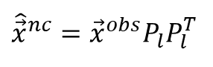
Exercise 1: Solution
Measured signals at present time:
Step 1: find principal components
Step 2 (PCA approximation): keep only 1 PC of ,i.e.
Step 3 (antitrasform):
$${\hat{\vec{x}}}^{nc}={\vec{x}}^{obs}P_{l}P_{l}^{T}$$
normal condition

Slide 65
Exercise 2
Measured signals at present time:
Signal reconstructions?
Normal or abnormal condition?
available historical signal measurements in normal plant condition

Slide 66
Exercise 2: Solution
Measured signals at present time:
Step 1: find principal components
Step 2 (PCA approximation): keep only 1 PC of ,i.e.
PC1

Slide 67
Exercise 2: Solution
Measured signals at present time:
Step 1: find principal components
Step 2 (PCA approximation): keep only 1 PC of ,i.e.
PC1

Slide 68
Exercise 2: Solution
Measured signals at present time:
Step 1: find principal components
Step 2 (PCA approximation): keep only 1 PC of ,i.e.
Step 3 (antitrasform):
$${\hat{\vec{x}}}^{nc}={\vec{x}}^{obs}P_{l}P_{l}^{T}$$
Abnormal condition

Slide 69
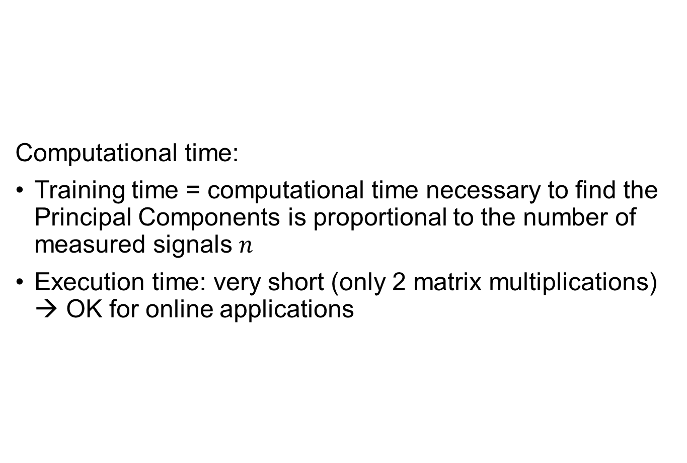
PCA remarks: computational time
Computational time:
Training time = computational time necessary to find the Principal Components is proportional to the number of measured signals $n$
Execution time: very short (only 2 matrix multiplications) → OK for online applications

Slide 70

PCA remarks: complex structure
Performance:
Unsatisfactory for dataset characterized by highly non-linear relationships

Slide 71
Part 2: Statistical Test
Signal
reconstructions
Real
measurements
Part 1
Part 2
MODEL OF THE
EQUIPMENT BEHAVIOR
IN NORMAL CONDITION
= ?
Statistical Test
Equipment
Normal
Condition
Abnormal
Condition

Slide 72
In This Lecture
Part 1: Model of the Equipment Behavior in Normal Condition
1A) Auto Associative Kernel Regression (AAKR)
1B) Principal Component Analysis (PCA)
Part 2: Statistical Test
2A) Thresholds-Based
2B) Q-Statistics
2C) Sequential Probability Ratio Test (SPRT)

Slide 73
PART 2: Statistical Test
Thresholds-based
Q Statistics
Sequential Probability Ratio Test (SPRT)

Slide 74
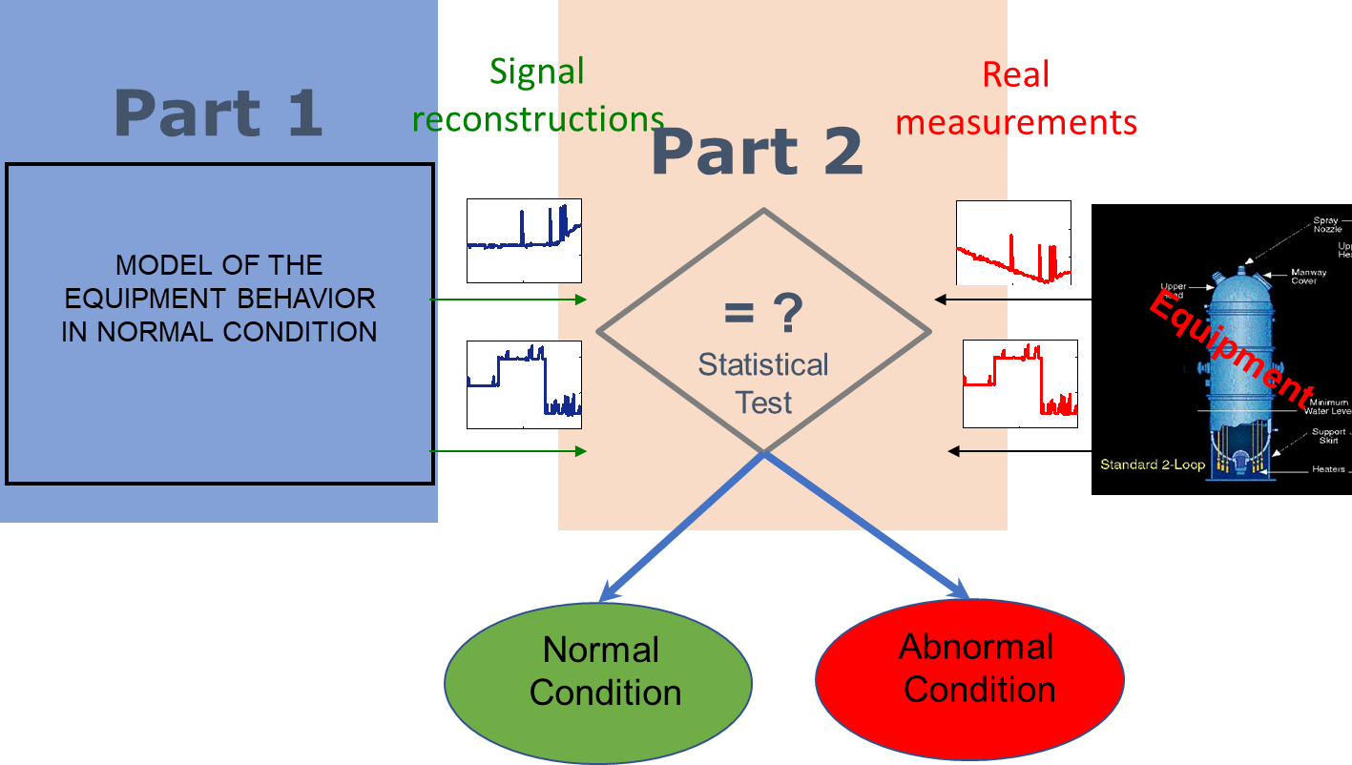
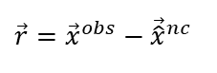
Abnormal condition detection: decision
Basics of the decision: residual analysis
Methods
Thresholds-based approach
Stochastic approaches:
Q Statistics
Sequential Probability Ratio Test (SPRT)
Normal condition
$$\vec{r}={\vec{x}}^{obs}−{\vec{\hat{x}}}^{nc}$$
Abnormal condition

Slide 75
PART 2 B: Statistical Test
Thresholds-based
Q Statistics
Sequential Probability Ratio Test (SPRT)

Slide 76
Thresholds-based
Abnormal condition
detection
r
t

Slide 77
Thresholds-Based: Remarks
Easy to apply
Thresholds setting is difficult and error-prone
Too small thresholds → high false alarm rates (α)
Normal conditions
r
t
Too large thresholds → high missing alarm rates (β)
r
Abnormal conditions
t

Slide 78
PART 2 B: Statistical Test
Thresholds-based
Q-Statistics
Sequential Probability Ratio Test (SPRT)

Slide 79
Stochastic approaches
Residual (r)= random variable described by a probability law
The probability law is different in case of normal/abnormal condition
Normal condition
Abnormal condition
EXAMPLE
~
~

Slide 80
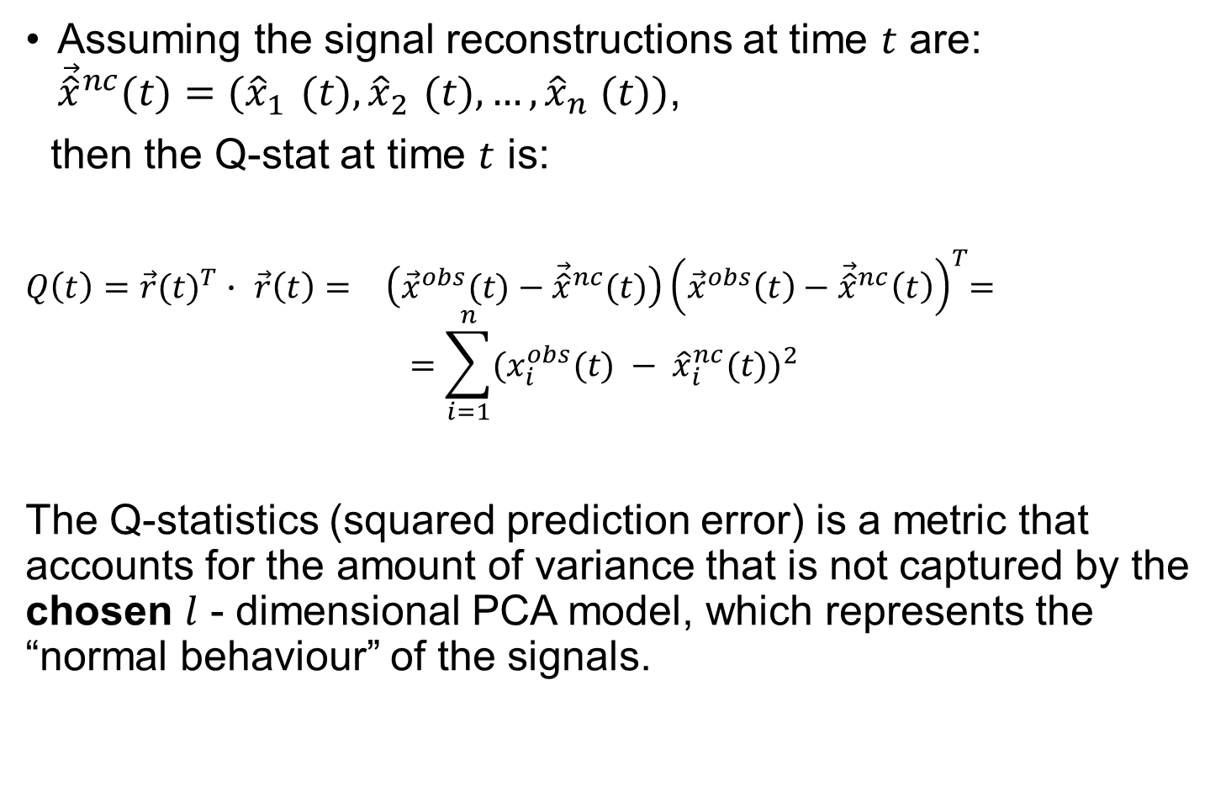
Q statistics
Assuming the signal reconstructions at time $t$ are: ${\vec{\hat{x}}}^{nc}(t)=({\hat{x}}_{1}^{}(t),{\hat{x}}_{2}^{}(t),…,{\hat{x}}_{n}^{}(t))$,
then the Q-stat at time $t$ is:
$Q\left(t\right)={\vec{r}(t)}^{T}∙ {\vec{r}\left(t\right)=}^{}\left({\vec{x}}^{obs}(t)−{\vec{\hat{x}}}^{nc}(t)\right){\left({\vec{x}}^{obs}\left(t\right)−{\vec{\hat{x}}}^{nc}\left(t\right)\right)}^{T}$=
$$=\sum_{i=1}^{n}{{{(x_{i}^{obs}(t) − \hat{x}}_{i}^{nc}(t))}^{2} }$$
The Q-statistics (squared prediction error) is a metric that accounts for the amount of variance that is not captured by the chosen $l$ - dimensional PCA model, which represents the “normal behaviour” of the signals.

Slide 81
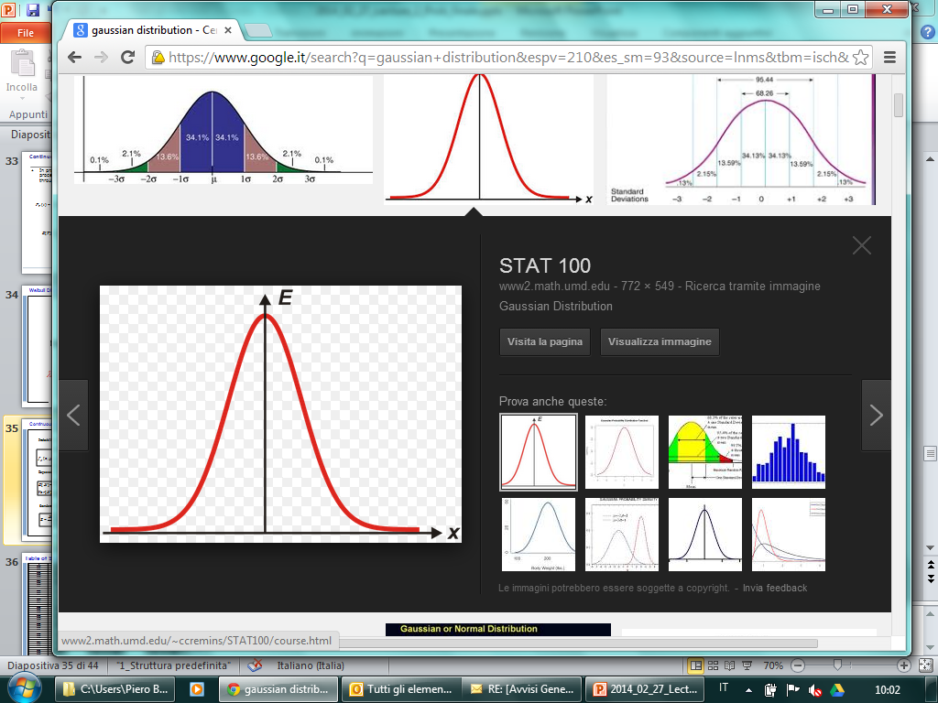
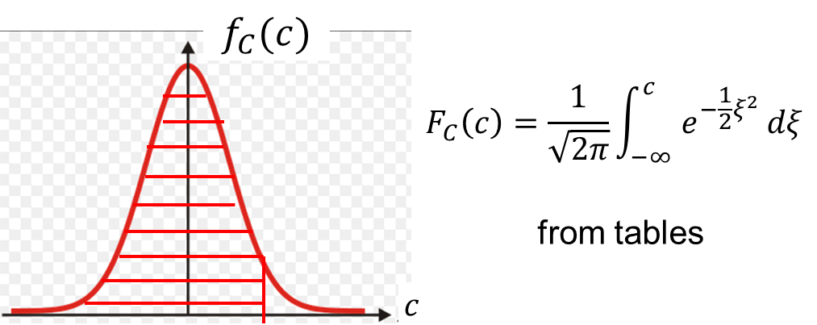
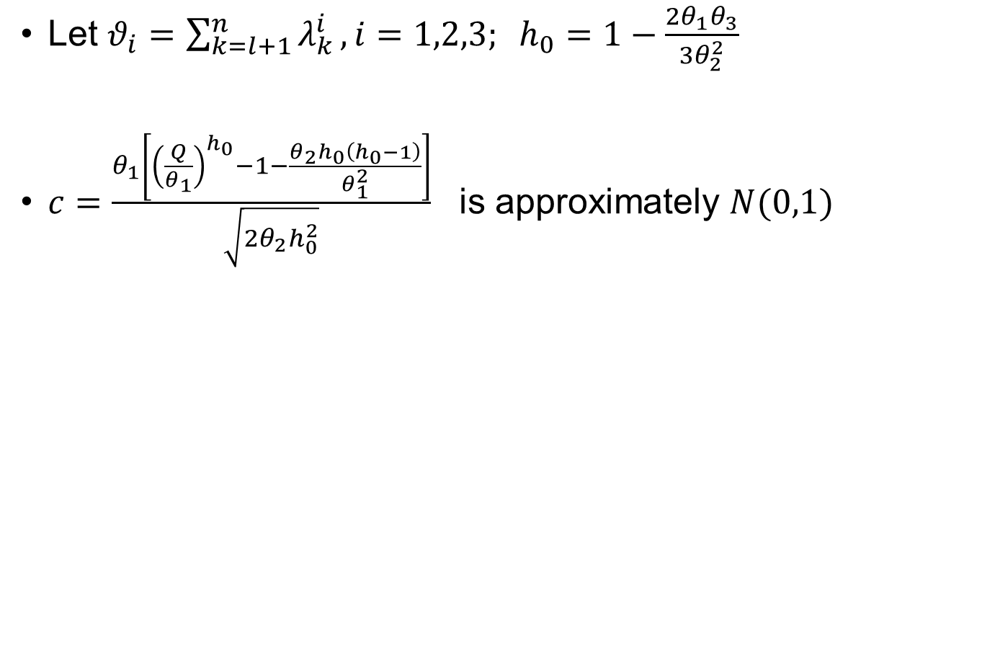
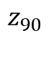

Q Statistics
Let $θ_{i}=\sum_{k=l+1}^{n}{λ_{k}^{i}}, i=1,2,3; h_{0}=1−\frac{2θ_{1}θ_{3}}{3θ_{2}^{2}}$
$c=\frac{θ_{1}\left[{\left(\frac{Q}{θ_{1}}\right)}^{h_{0}}−1−\frac{{θ_{2}h}_{0}\left(h_{0}−1\right)}{θ_{1}^{2}}\right]}{\sqrt{2θ_{2}h_{0}^{2}}}$ is approximately $N(0,1)$
Theorem ,see Appendix 1, J.E. Jackson and G.S. Mudholkar, Technometrics, 21(3), (1979), 341-349
$$f_{C}(c)$$
c
$$z_{90}$$
Equipment in normal condition → $P(c≤z_{90})$=0.9
Notes:
c is a random quantity and it is a pivotal quantity. Its distribution does not depend from parameters. So I perfectly known its distribution. It means I can compute its percentile. Here I am considering the 90° percentile. The prob… is . Frome

Slide 82






Q Statistics
$$Q_{α}=θ_{1}{\left(\frac{h_{0}z_{α}\sqrt{2θ_{2}}}{θ_{1}}+1+\frac{h_{0}θ_{2}\left(h_{0}−1\right)}{θ_{1}^{2}}\right)}^{1/h_{0}}$$
→ $P(Q≤Q_{90})$=0.9
Abnormal condition
detection
$$Q$$
$$Q_{α}$$
t
$P(abnormal condition|normal condition)$=0.1
FALSE POSITIVE

Slide 83
PART 2 B: Statistical Test
General Idea
Q Statistics
Sequential Probability Ratio Test (SPRT)

Slide 84

SPRT
$R_{T}=\{r^{\left(1\right)},…,r^{\left(T\right)}\}$ sequence of residuals at time $t = 1,…T$, where $r^{\left(t\right)}=x^{obs}(t) −{\hat{x}}^{nc}(t)$
Binary hypothesis test:
Null hypothesis (H₀) ≡ Normal condition
$$r^{\left(t\right)}\sim 𝒩\left(0,σ\right), ∀t$$
Alternative hypothesis (H₁) ≡ Abnormal condition
$$r^{\left(t\right)}\sim 𝒩\left(μ_{1},σ\right), ∀t$$
Notes:
Here we consider the signals, one by one.

Slide 86


SPRT: the decision
$$L_{T}=\frac{P\left\{R_{T}|H_{1}\text{is} \text{true}\right\}}{P\left\{R_{T}|H_{0}\text{is} \text{true}\right\}}=\frac{f_{1}\left(r^{\left(1\right)}\right)⋅f_{1}\left(r^{\left(2\right)}\right)⋅...⋅f_{1}\left(r^{\left(T\right)}\right)}{f_{0}\left(r^{\left(1\right)}\right)⋅f_{0}\left(r^{\left(2\right)}\right)⋅...⋅f_{0}\left(r^{\left(T\right)}\right)}$$
$$\ln\left(L_{T}\right)$$
Not enough
information

Slide 87
SPRT Theorem
False alarm
Missing alarm
Notes:
How to fix the thresholds A and B? There is a theorem that can help us, as often in statistics (-;, The theorem uses other two parameters alpha and beta that have a clear statistical interpretation…
Alpha can be linked to the probability of false alarmrms …D1= decision abnormal when …
Why we shouldn’t choose alpha and beta verysmall???
No free lunch… → big uncertainty zone

Slide 88



SPRT for the positive mean test
Null hypothesis (H₀) ≡ Normal condition $r^{\left(t\right)}\sim 𝒩\left(0,σ\right)$
Alternative hypothesis (H₁) ≡ Abnormal condition $r^{\left(t\right)}\sim 𝒩\left(μ_{1},σ\right)$
$$L_{T}=\frac{P(r^{\left(1\right)},…,r^{\left(T\right)}|H_{1})}{P(r^{\left(1\right)},…,r^{\left(T\right)}|H_{0})}=e^{−\frac{1}{2σ^{2}}\sum_{t=1}^{T}{μ_{1}\left(μ_{1}−2r^{\left(t\right)}\right)}}=e^{\frac{μ_{1}}{σ^{2}}\sum_{t=1}^{T}{\left(r^{\left(t\right)}−\frac{μ_{1}}{2}\right)}}$$
$$\ln\left(L_{T}\right)=\frac{μ_{1}}{σ^{2}}\sum_{t=1}^{T}{\left(r^{\left(t\right)}−\frac{μ_{1}}{2}\right)}=\frac{μ_{1}}{σ^{2}}\sum_{t=1}^{T−1}{\left(r^{\left(k\right)}−\frac{μ_{1}}{2}\right)}+\frac{μ_{1}}{σ^{2}}\left(r^{T}−\frac{μ_{1}}{2}\right)=\ln{(}L_{T−1})+\frac{μ_{1}}{σ^{2}}\left(r^{\left(T\right)}−\frac{μ_{1}}{2}\right)$$
Sequential
Formula!

Slide 89


SPRT: Example
$$\ln\left(L_{T}\right)$$
$$L_{0}=1→\ln{(}L_{0})=0$$
$$\ln\left(L_{1}\right)=\ln\left(L_{0}\right)+\frac{μ_{1}}{σ^{2}}\left(r^{\left(1\right)}−\frac{μ_{1}}{2}\right) \\ \ln\left(L_{2}\right)=\ln\left(L_{1}\right)+\frac{μ_{1}}{σ^{2}}\left(r^{\left(2\right)}−\frac{μ_{1}}{2}\right)$$
Not enough
information
0
1
2
3
t
Not enough
information
Notes:
Fare esempio alla lavagna

Slide 90
SPRT: parameters to be set
the residual variance in normal condition (σ²)
the expected offset amplitude (μ₁)
the maximum acceptable false alarm rate (α)
the maximum acceptable missing alarm rate (β)

Slide 91
Example
Time interval | Simulated Offset
[0-200] | No
[201-400] | Yes (amplitude = 0.11)
[401-600] | Yes (amplitude = 0.23)
[601-800] | Yes (amplitude = 0.34)
[801-1000] | Yes (amplitude = 0.46)
observed
Notes:
We have a plant, several signals,…, one one signals we apply an anomaly of intensity increasing with time. Show…, here you see the observed value… and the reconstruction obrtained by the AAKR… notice that … Spiegare piano il caso studio

Slide 92
Example: residuals
No offset
Maximum offset

Slide 93

Example: SPRT
Parameter | Value
α | 0.01
Β | 0.01
μ₀ | 0
μ₁ | 0.46
σ² | 0.12
$$L_{0}=1→\ln{(}L_{0})=0$$
$$\ln\left(L_{1}\right)=\ln\left(L_{0}\right)+\frac{μ_{1}}{σ^{2}}\left(r^{\left(1\right)}−\frac{μ_{1}}{2}\right) \\ \ln\left(L_{2}\right)=\ln\left(L_{1}\right)+\frac{μ_{1}}{σ^{2}}\left(r^{\left(2\right)}−\frac{μ_{1}}{2}\right)$$
No offset
Maximum offset
Notes:
Fare esempio alla lavagna

Slide 94
SPRT: performance
Average Sample Number (ASN) needed to deliver a decision
Time interval | Offset | Estimated ASN | Number of times in which a normal condition has been detected | Number of times in which an abnormal condition has been detected
[0-200] | No | 1.2 | 150 | 2
[201-400] | amplitude = 0.11 | 1.9 | 70 | 5
[401-600] | amplitude = 0.23 | 2.4 | 15 | 17
[601-800] | amplitude = 0.34 | 2.1 | 0 | 94
[801-1000] | amplitude = 0.46 | 1.2 | 2 | 142

Slide 95
Case Study 1:
Monitoring Reactor Coolant Pumps

Slide 96
Case Study (EdF)
96
COMPONENT TO Reactor Coolant Pumps of a PWR
BE MONITORED Nuclear Power Plant
x4
__________________________________________________
MEASURED 94 signals, 48 of which considered
SIGNALS as most important by EdF experts
__________________________________________________
RECONSTRUCTION Auto-Associative Kernel Regression
MODEL (AAKR)
historical measurements
test measurements
reconstruction

Slide 97
Problem Statement (EdF): hundreds of signals → Grouping
97
AUTO-ASSOCIATIVE
MODEL OF PLANT BEHAVIOR IN NORMAL CONDITION
MEASURED
SIGNALS
COMPARISON
MODEL 1
MODEL 2
…
MODEL m
Notes:
Coarse of dimensionality

Slide 98
Challenge: Optimal Grouping
98
MEASURED
SIGNALS
COMPARISON
MODEL 1
HOW TO GROUP SIGNALS
?
MODEL 2
…
MODEL m

Slide 99
Approaches to signal grouping
99
HOW TO SPLIT THE SIGNALS INTO SUBGROUPS?
A-PRIORI CRITERIA
(signals divided on the basis of…)
location in the power plant
correlation
physical homogeneity
others

Slide 100

Results
100
best a-priori grouping: “correlation”
Criticality: how to group the signals which have a low degree of correlation with all the others?
signals
33
WHITE: high correlation (0.7 1]
GREY: medium correlation (0.4 0.7]
BLACK: low correlation [0 0.4]
11
signal belonging to group 1
signal belonging to group 2
signal belonging to group 3
signal belonging to group 4
signal belonging to group 5
signals
4

Slide 101
Results: reconstruction of simulated sensor failures
SENSOR: Temperature of the water flowing to the first seal of the pump in line 1:
Failure 1 = measurement noise increase
residual
Failure 2 = sensor offset
residual
Failure 3 =sensor stuck
residual
Fault injection
Notes:
To test the method before its use, we have simulated data over normal conditions. In practice …

Slide 102



Results: seal deterioration detection
102
AUTO-ASSOCIATIVE MODEL OF PLANT BEHAVIOR IN NORMAL CONDITIONS
ŝ₁
t
COMPARISON
MEASURED SIGNALS
s₁ – ŝ₁
s₁
(seal
outcoming
flow)
t
DECISION
t
ABNORMAL CONDITION: seal deterioration
NORMAL
CONDITION
ABNORMAL
CONDITION

Slide 103
Data-Driven Fault Detection
Challenges?

Slide 104




Data-Driven Fault Detection: Challenge I
Hundreds of signals are monitored
Signal
reconstructions
EMPIRICAL MODEL OF
PLANT BEHAVIOR
IN NORMAL OPERATION
(AAKR, PCA, ANN)
$$x_{1}$$
$$x_{2}$$
$$x_{123}$$
DIFFICULT TO DEVELOP

Slide 105
Fault Detection: Challenge I
Ensemble of models
Solution
Subset 1
Model 1
Measured
Signals
Group generation
Subset 2
Model 2
Random
…
123 signals
Subset H
Model H
≈30 signals

Slide 106
Fault Detection: Challenge I
Ensemble of models
Solution
Subset 1
Model 1
Aggregation
Measured
Signals
Group generation
Subset 2
Model 2
Random
…
123 signals
Weighted
Average
Subset H
Model H
≈20 signals

Slide 107
Fault Detection: Challenge II
Evolving Environment
Plant Upgrading: Valve ‘64y’ is replaced with a new model
Plammed Maintenance
Operational Condition:
Load 100% →
Load 80%
Inlet Gas
Temperature
2012
2015
2019

Slide 108
Fault Detection: Challenge II
Example: monitoring the turbine of an electric power plant
Identify historical signal measurements in
normal plant operation
Plant operations slowly
change with time
Develop the model
False
alarm
rate
t₀
P
P
T
T
t₀
t₁
time
A New Model is necessary

Slide 109
Fault Detection: Challenge II
Example: monitoring the turbine of an electric power plant
Identify historical signal measurements in
normal plant operation
Plant operations slowly
change with time
Develop the model
False
alarm
rate
t₀
P
P
T
T
t₀
t₁
time
Identify recent historical signal measurements in
normal plant operation
A New Model is necessary
Develop the new model
False
alarm
rates
t₁
P
P
T
T
t₀
t₁
time
Periodic Human Interventions for developing new models! → high costs!

Slide 110
Fault Detection: Challenge II
The detection model should be able to follow the process changes:
Incremental learning of the new data that gradually becomes available
No necessity of human intervention for:
selecting recent normal operation data
building the new model
New data are coming
P
P
T
T
Automatic updating of the model
P
T

Slide 111
Fault Detection: Challenge III
Robustness of the Reconstruction
ROBUSTNESS:
ABNORMAL CONDITION
Real
measurements
Signal
reconstructions
M
O
D
E
L
OK
t
t
t
t

Slide 112









Example: Monitoring a Turbine for Energy Production
6 Temperature Sensors
in different position
$$x_{1}$$
$$x_{2}$$
$$x_{3}$$
$$x_{4}$$
$$x_{5}$$
$$x_{6}$$
Abnormal condition of the first signal
Highly Correlated Signals
 | $$x_{1}$$ | $$x_{2}$$ | $$x_{3}$$ | $$x_{4}$$ | $$x_{5}$$ | $$x_{6}$$
$$x_{1}$$ | 1 | 0.97 | 0.98 | 0.98 | 0.99 | 0.98
$$x_{2}$$ | 0.97 | 1 | 0.95 | 0.99 | 0.98 | 0.96
$$x_{3}$$ | 0.98 | 0.95 | 1 | 0.96 | 0.99 | 0.99
$$x_{4}$$ | 0.98 | 0.99 | 0.96 | 1 | 0.98 | 0.97
$$x_{5}$$ | 0.99 | 0.98 | 0.99 | 0.98 | 1 | 0.99
$$x_{6}$$ | 0.98 | 0.96 | 0.99 | 0.97 | 0.99 | 1

Slide 113
Example: Traditional AAKR
1
2
Simulated abnormal conditions
Simulated abnormal conditions
DELAY IN THE DETECTION
IMPOSSIBILITY TO IDENTIFY THE SIGNALS
TRIGGERING THE ABNORMAL BEHAVIOR
Notes:
Spill-over…

Slide 114















Our Contribution: A modified AAKR method
$$x_{1}$$
Fault
$${\vec{x}}^{obs}$$
$$Δ\vec{x}$$
Fault
Detection
$$x_{2}$$
-
No Fault
Modified AAKR
$${\vec{x}}^{nc}$$
$$x_{2}$$
Malfunctions causing variations
of a small number of signals are
more frequent than those
causing variations of a large
number of signals
$${\vec{x}}^{hist}\left(2\right)$$
$$x_{2}$$
$${\vec{x}}^{hist}\left(1\right)$$
$${\vec{x}}^{hist}\left(2\right)$$
$${\vec{x}}^{obs}$$
$$x_{1}$$
$${\vec{x}}^{hist}\left(1\right)$$
$${\vec{x}}^{obs}$$
$$x_{1}$$
Modification of the loci
of equisimilarity points

Slide 115
Results
Early Detection
More Accurate
$$x_{1}$$
$$x_{2}$$
$$x_{3}$$
Correct Diagnosis of the signal that triggers the alarms
$$x_{4}$$
$$x_{5}$$
$$x_{6}$$

Slide 116



Modified AAKR
 | Traditional AAKR | Modify AAKR
Loci of equisimilarity points
Accuracy | OK! | OK!
Robustness | NO! Especially with correlated signals | Robust reconstruction of the values expected in normal conditions Correct identification of signals affected by abnormal condition Good performance with correlated signals
$$x_{2}$$
$$x_{2}$$
$${\vec{x}}^{hist}\left(2\right)$$
$${\vec{x}}^{hist}\left(2\right)$$
$${\vec{x}}^{hist}\left(1\right)$$
$${\vec{x}}^{hist}\left(1\right)$$
$${\vec{x}}^{obs}$$
$$x_{1}$$
$${\vec{x}}^{obs}$$
$$x_{1}$$

Slide 117
Fault Detection - Challenges
Hundreds of Signals are Monitored
Evolving Environment
Robustness
…

